Slide 1



SKYHACK 2.0 Submission
(By Team NeuralBrains)
Presentation by Aryan Arora and Prajwal Sharma (PEC CSE)
Please check our repository to view all our work and code
Here’s the link: https://github.com/aryamanan/NeuralBrains

Slide 2


1
Problem Statement
Data Preparation and Exploratory Data Analysis
2
Agenda
Final Insights and recommendations
3
Topics Covered
Optional Problem: Optional Problem: Primary Reason prediction using Text Classification Model
3

Slide 3

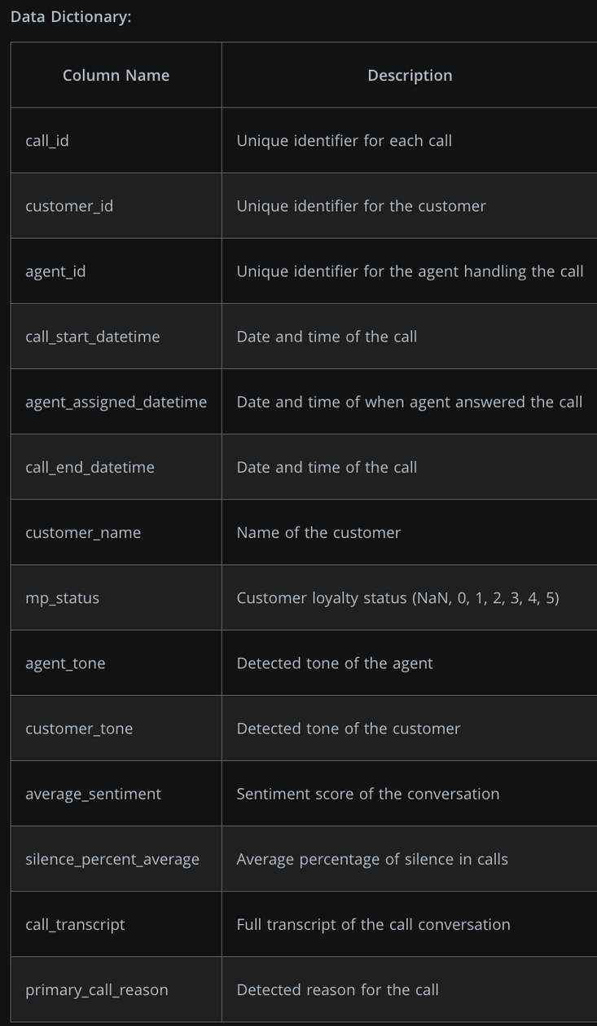

Problem Statement
Give insights and recommendations that allow organisation to minimize metrics AHT and AST by finding patterns in the data:
Where:
AHT: This measures how long agents spend on each call:
AHT=Total Handle Time / Total Number of Calls
AST: This measures how long customers wait before reaching an agent.
AST=Total Waiting Time / Total Number of Calls

Slide 4

Data Preparation and EDA

Slide 5
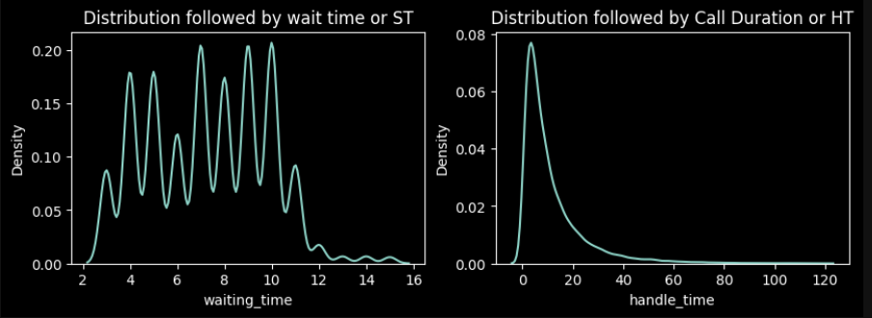
Distribution Followed By ST and HT

Slide 6

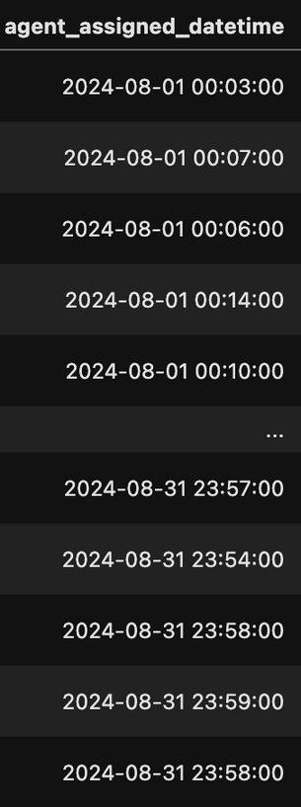
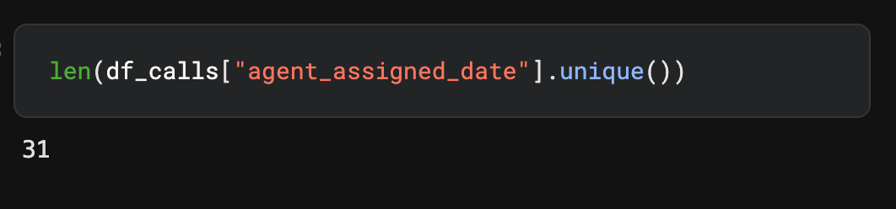
Observation: We find out that this data contains records about calls that were assigned to agents over a period of 1 month, starting from 01-08-2024 and ending on 31-08-2024 (DD-MM-YYYY)
Observation: Work was done all 31 days, but we still don't know how many days an average worker works, that means we don't know average working days / working hours for an employe

Slide 7



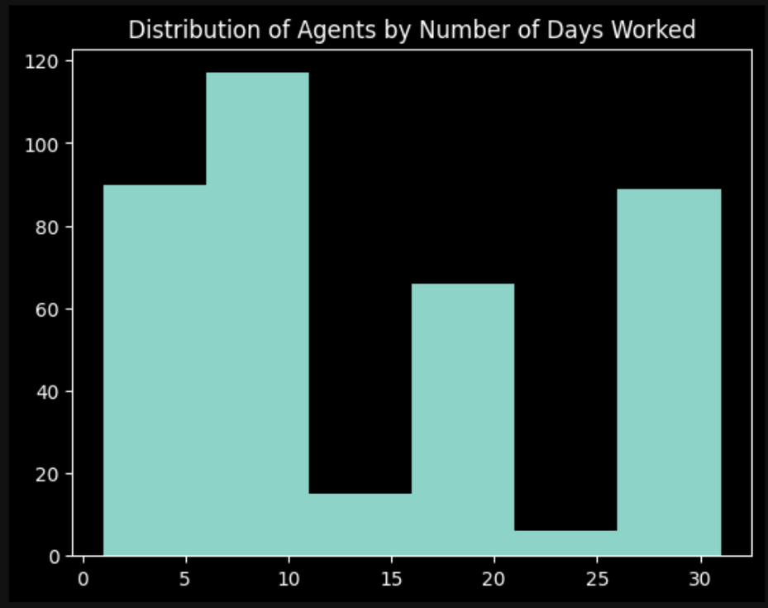
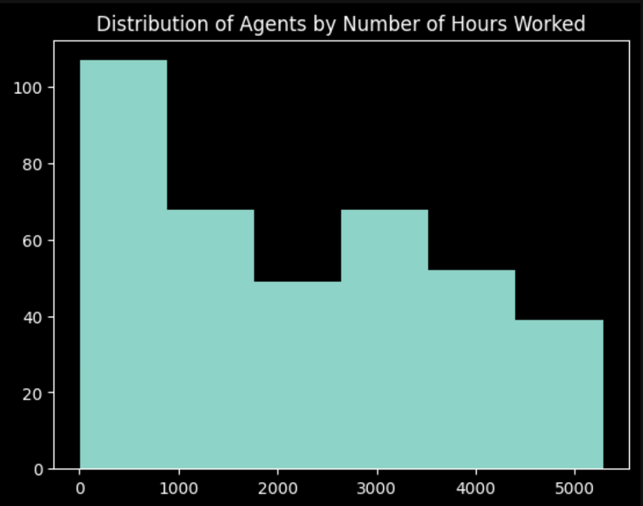
Finding Effect of no of agents and their performance on Waiting and Handle Time

Slide 8

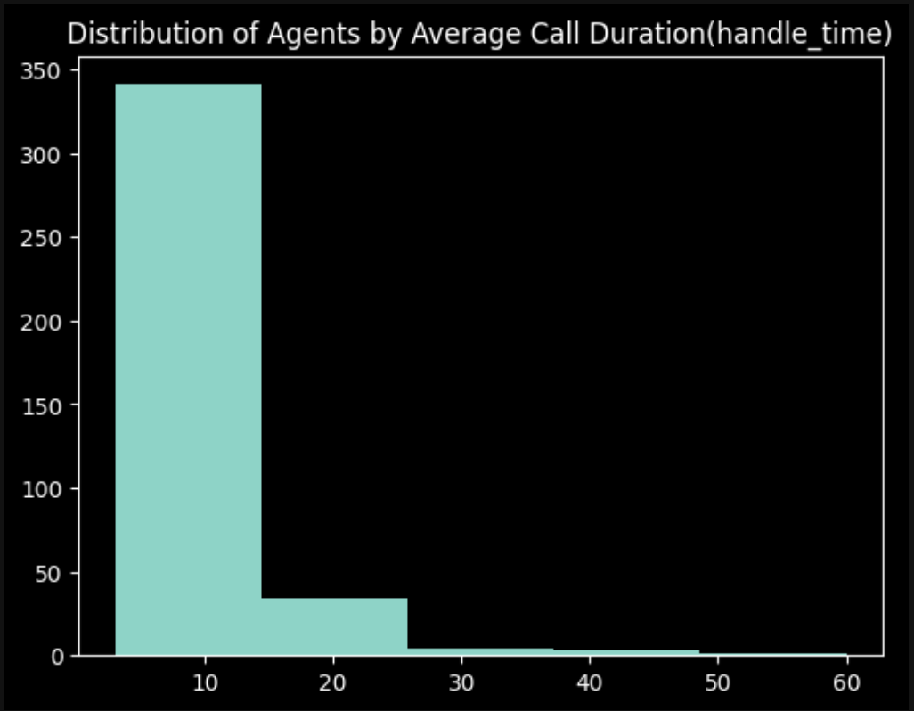
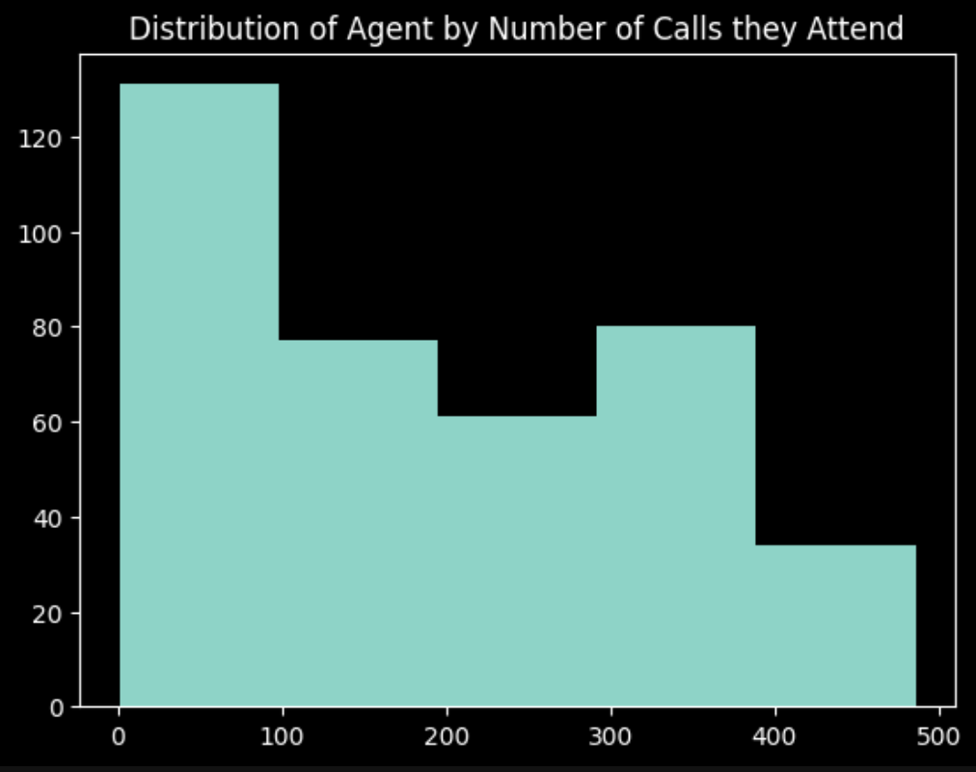
Observation: We had 383 agents working in the month, a big chunk of them only handle calls when our limited permanent agents are overburdened, ie temporary hires

Slide 9
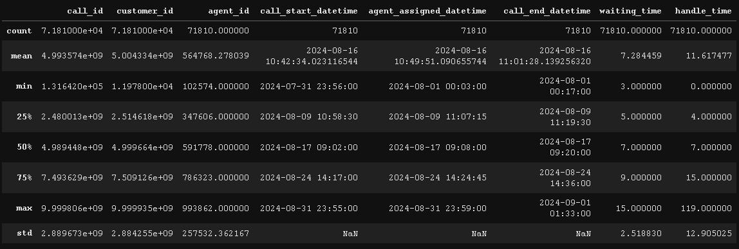
How working hours and agent attendance (physical or IVF) is distributed over weekdays

Slide 10
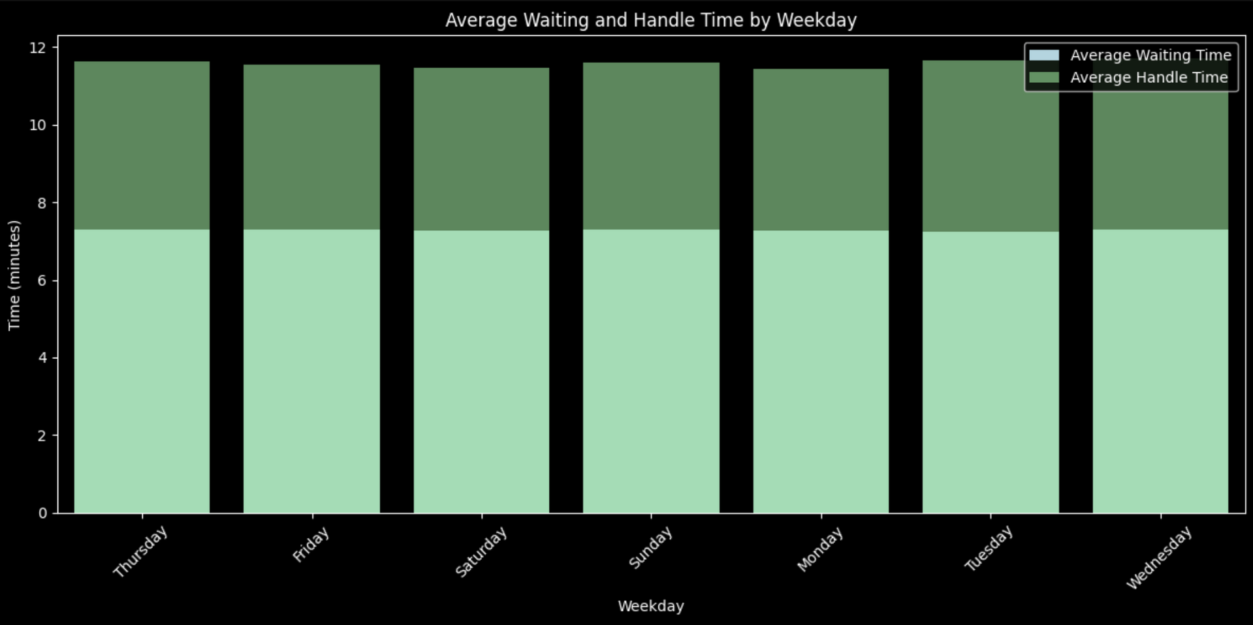
Observation: We find out there's no difference in work based on weekdays

Slide 11
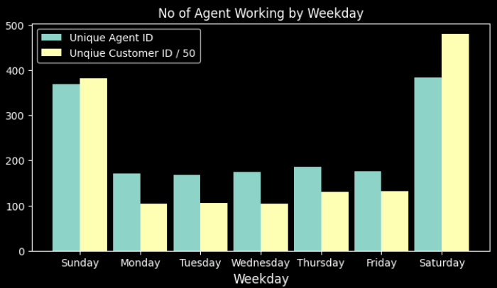
Observation: We find out no of agents working might be different for each weekday, but It can also be due to IVF

Slide 12
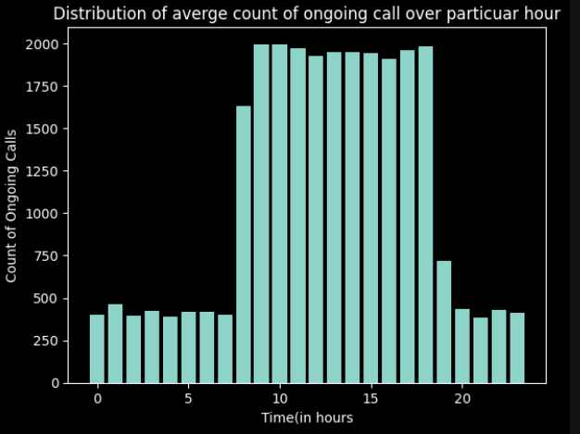
Peak Hours: What hours recieve most amount of calls in a day (0-24)
Observation: Our peak hours are 8 AM to 6 PM

Slide 13
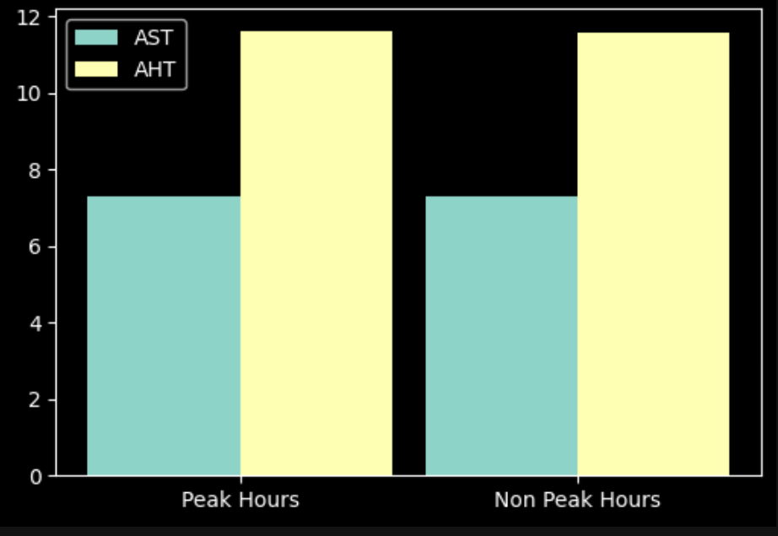

Peak Hours: Time within the day where we get more call traffic than usual
Observation: It has no significant effect
How calliing during peak or non peak hours effects AST and AHT

Slide 14
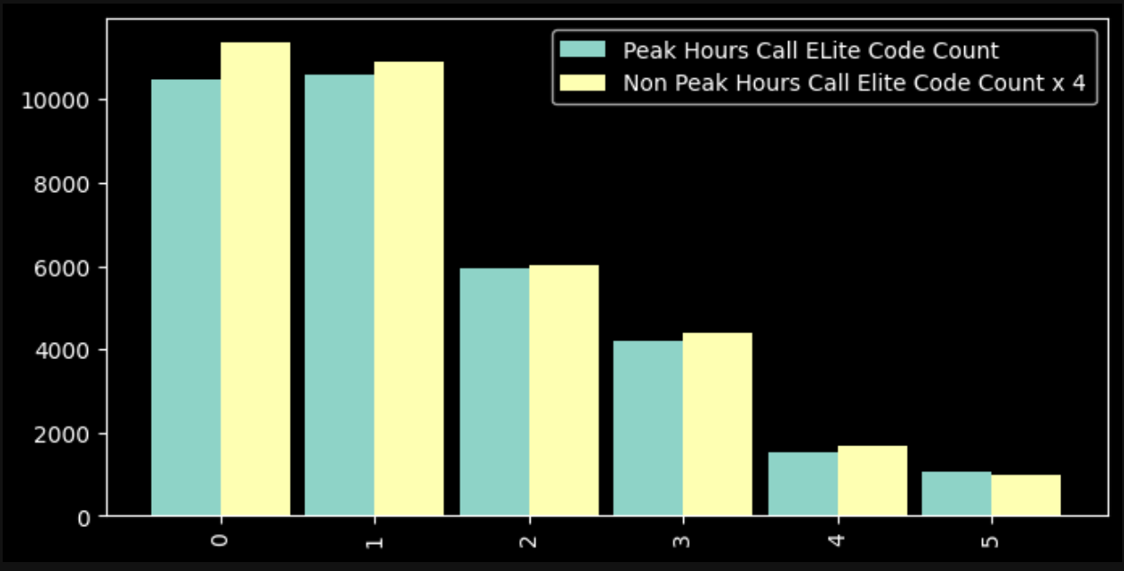
Elite Code Queries distribution in both peak and non peak hours
Observation: It has no significant effect

Slide 15
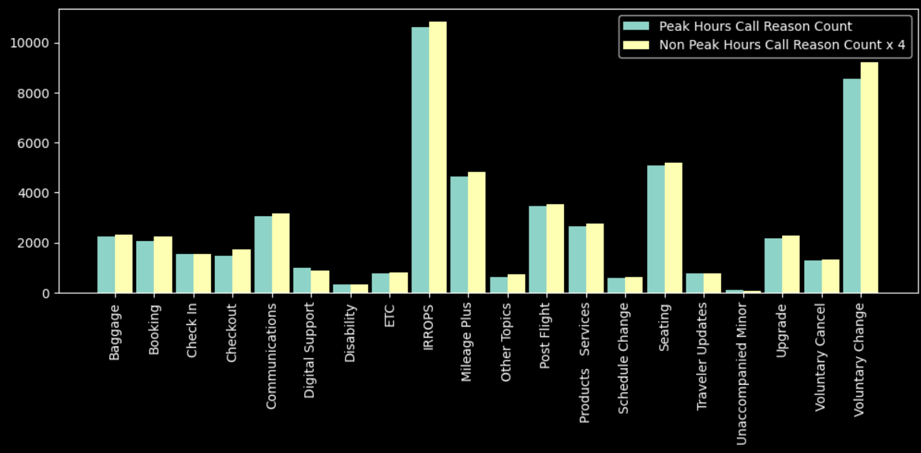

Distribution of primary reasons to call depending on peak and non peak hours
Observation: It has no significant effect

Slide 16
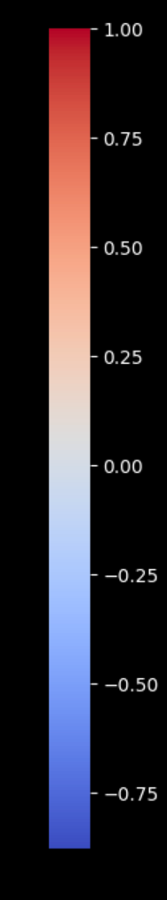
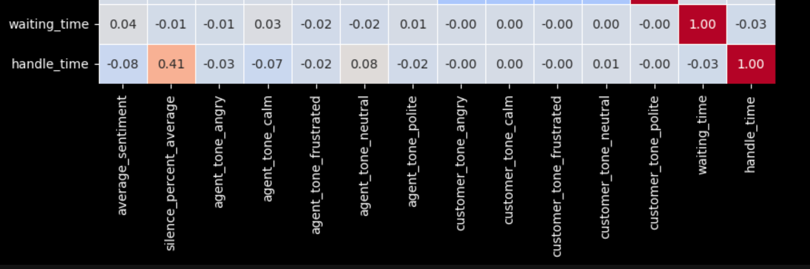
Sentiment Correlation Heatmap
Observation: Handle Time is positively correlated on the percentage of silent time, no other important stat is found from this heatmap

Slide 17
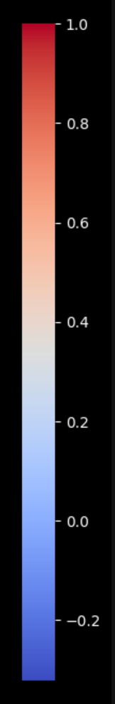
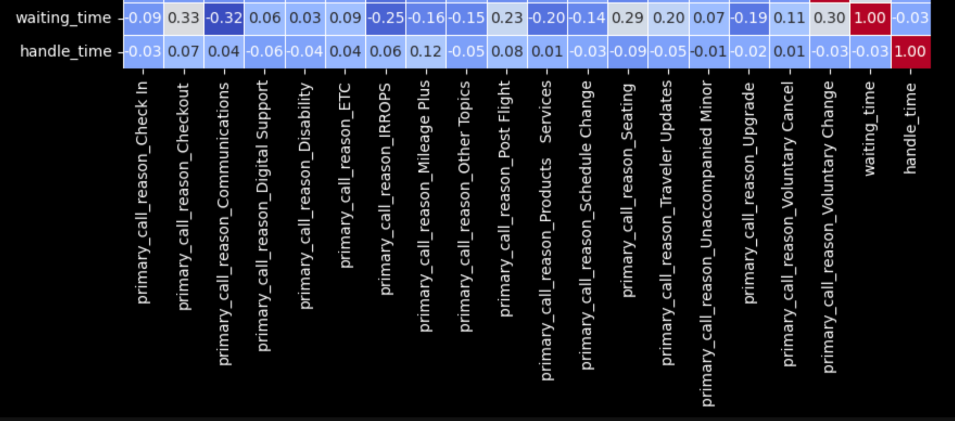
Primary Reason Correlation Heatmap
Observation: We find both positive and negative correlations between various primary call reasons and waiting time, but primary call reasons have no significant effect on handle time

Slide 18
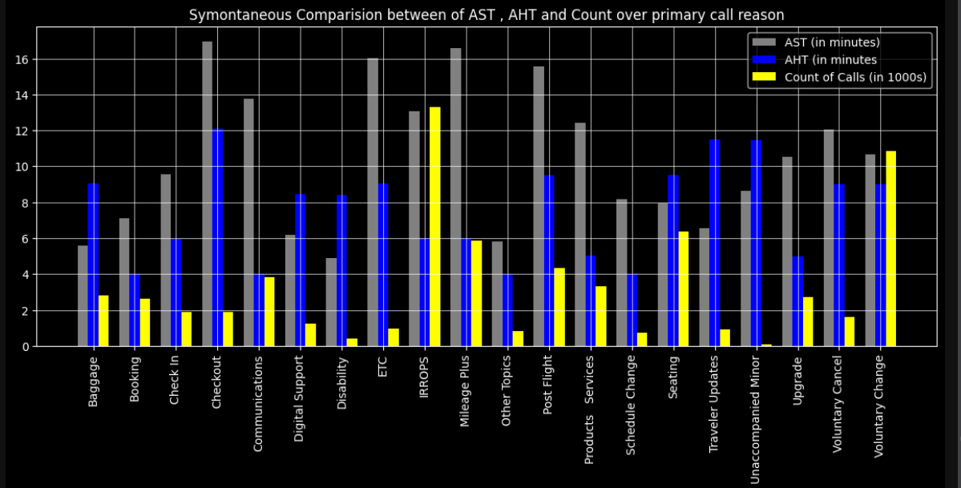

Distribution of Primary Reasons over number of calls in a month [in thousands] , AHT [in minutes] and AST [in minutes]

Slide 19
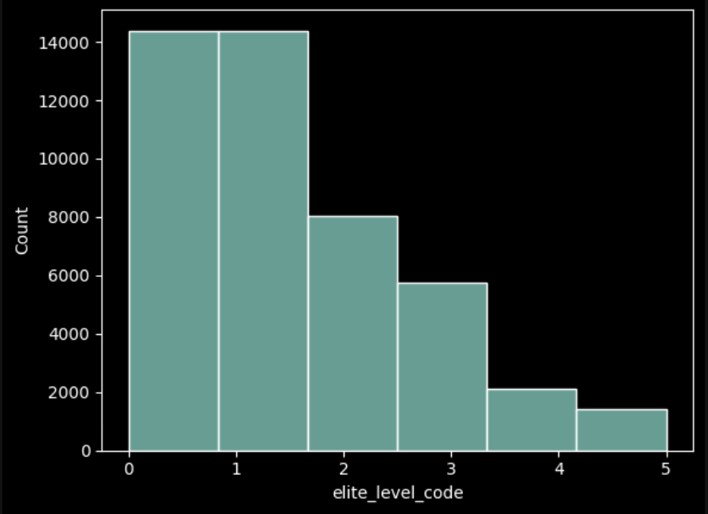
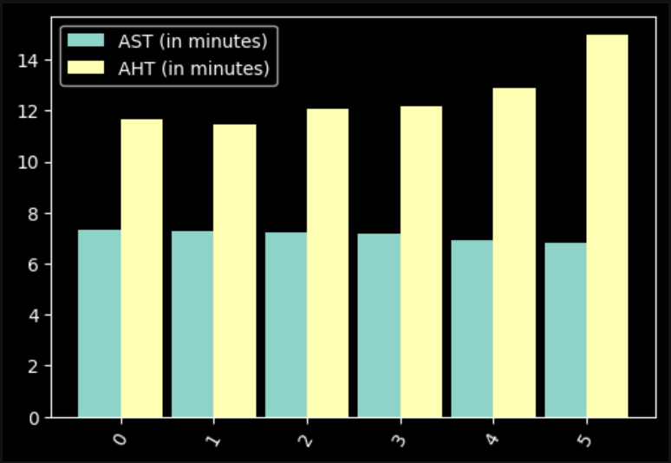







Distribution over the count of Elite Code
AHT and AST based on Elite Code
Observation 1: Most people who query have low Elite Code (customer loyalty status), which is a natural stat
Observation 2: AHT(call duration) increases as a query with higher Elite Code (customer loyalty status)

Slide 20
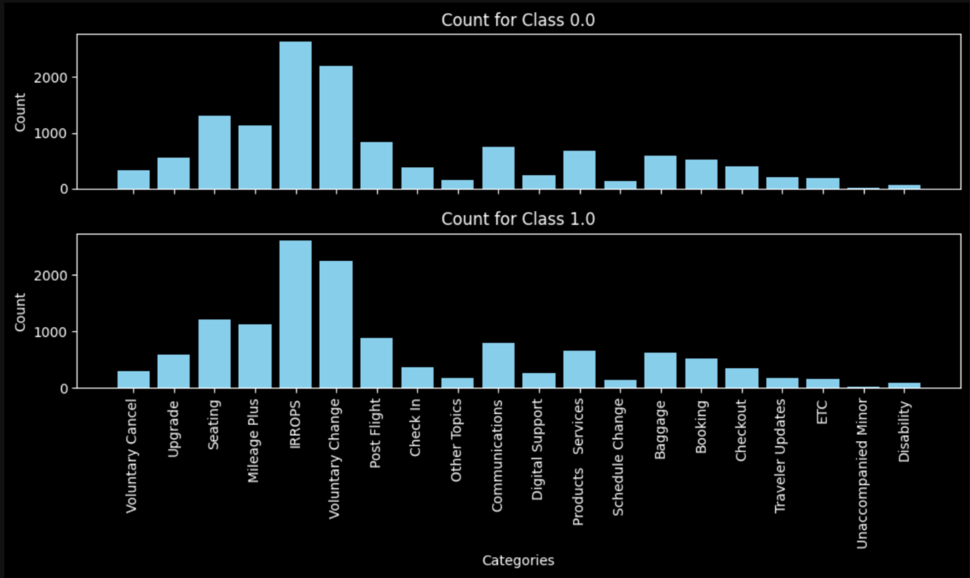







Count of the primary reason for the query based on their Elite Code

Slide 21
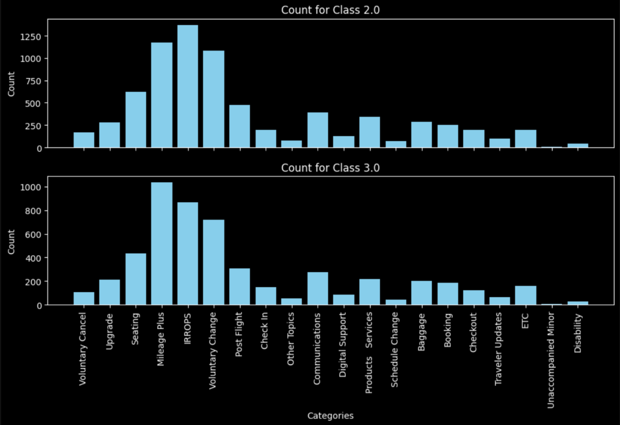
Count of the primary reason for the query based on their Elite Code

Slide 22
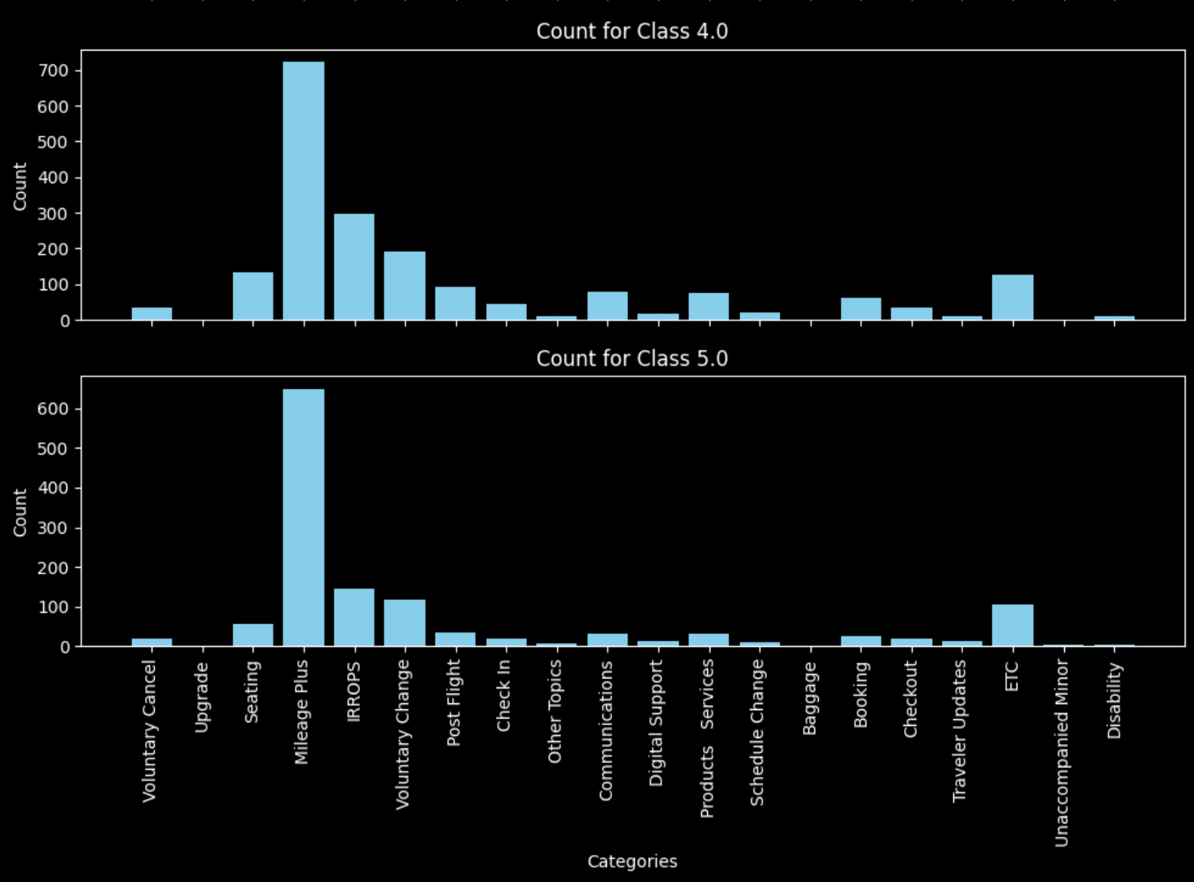
Count of the primary reason for the query based on their Elite Code

Slide 23
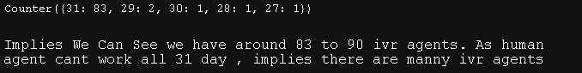
IVR Consideration
We assume that , the agent id working more than 26 days in a week are actuallly IVR and rest are Non-IVR (i,e human agent)

Slide 24
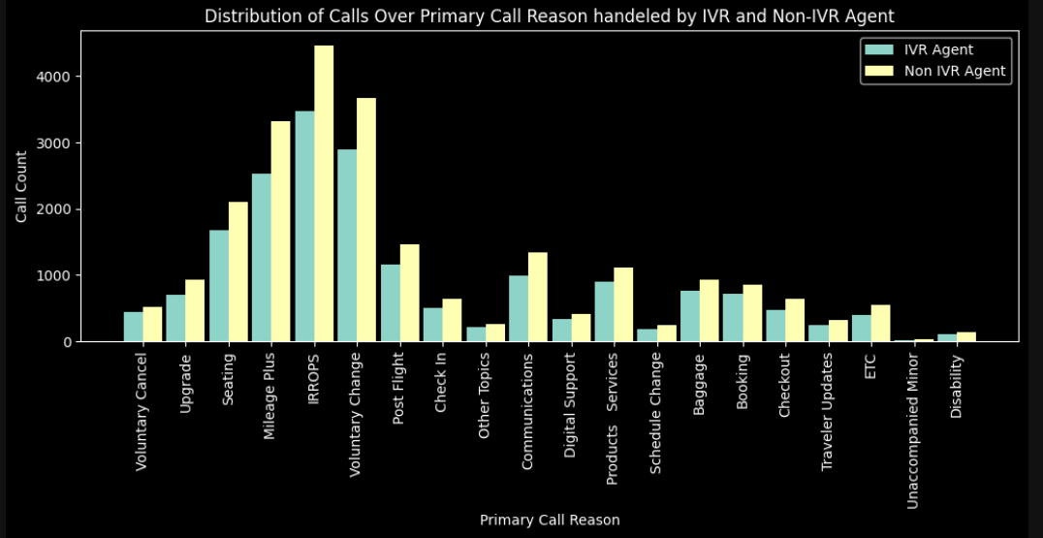

Slide 25
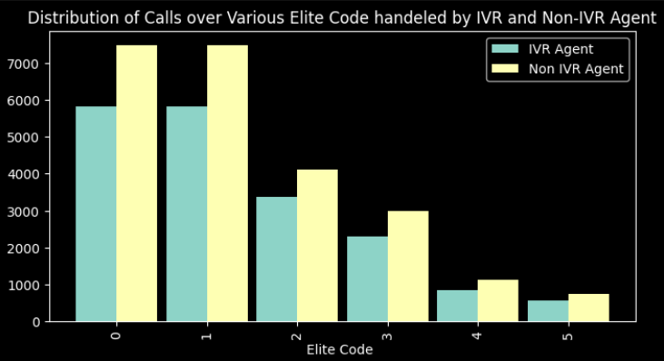
Observation:There is no change iin AHT , AST , Primary Call Reason and Eliite Code of customer wheater it is IVR Agent or Non - IVR Agent

Slide 26
Final Insights and Recommendations

Slide 27
Recommendations based on Primary Reasons
Reasons to push to the front of the queue (decrease AST for these primary reasons):
Mileage Plus: Highest call volume across all classes, relatively low AHT.
IRROPS (Irregular Operations): High call volume, moderate AHT, likely time-sensitive.
Voluntary Change: High call volume, low AHT.
Post Flight: Moderate call volume, very low AHT.
Digital Support: Low call volume but very low AHT, can be resolved quickly.
Reasons to push to the back of the queue (can tolerate higher AST):
Seating: High AHT, moderate call volume.
Schedule Change: High AHT, moderate call volume.
Products Services: High AHT, low call volume.
Baggage: High AHT, low call volume.
Unaccompanied Minor: Very high AHT, low call volume.

Slide 28
More Changes due to Primary Reasons
For high-volume categories (e.g., Mileage Plus, IRROPS), consider creating dedicated queues or teams to handle these efficiently.
Implement a dynamic queue system that adjusts priority based on wait time to prevent low-priority issues from being perpetually pushed back.
Offer callback options for lower priority, high AHT issues to manage queue length and customer satisfaction.
Provide self-service options for simple, high-volume issues like Digital Support and Post Flight to reduce overall call volume.

Slide 29
Recommendations based on Sentiments
Features to focus on:
primary_call_reason_Booking (-0.26 for waiting time, -0.07 for handle time):
Streamline the booking process
Provide more self-service booking options
Train agents to handle bookings more efficiently
silence_percent_average (0.41 for handle time):
Reduce silent time during calls
Improve agent access to information
Enhance agent training on quick information retrieval

Slide 30
More Changes due to Sentiments
To decrease both waiting and handle times:
Improve booking processes and self-service options
Reduce silence during calls by enhancing agent knowledge and information access
Focus on improving overall customer sentiment through better service
Train agents in emotional control, calm communication, and de-escalation techniques
Address sources of agent frustration to maintain a positive tone
Streamline baggage-related processes and provide more self-service options
Continuously train agents to handle common issues (like bookings and baggage) more efficiently
By focusing on these areas, we can potentially reduce both waiting times and handle times, improving overall customer service efficiency.

Slide 31
IVR System Enhancement
Priority Areas for IVR Automation
Focus on high-volume, low-complexity calls:
Voluntary Changes
Seating arrangements
Basic IRROPS updates
Mileage Plus basic inquiries
Specific IVR Improvements
Implement intelligent routing based on elite status
Add self-service options for top reasons:
Seat selection/changes
Basic flight changes
Status updates during IRROPS
Mileage balance checks
Your paragraph text

Slide 32
Agent Training and Support
Targeted Training Programs
Focus on high-AHT areas:
Checkout processes
Mileage Plus complex issues
Post-flight resolution
Develop specialized teams for:
Complex IRROPS handling
Elite member services
Voluntary changes
Process Optimization
Create standardized scripts for common scenarios
Implement real-time assistance tools
Develop better knowledge management systems

Slide 33
Resource Allocation Strategy
Peak Hours Management
Increase staffing during peak periods for:
IRROPS handling
Voluntary changes
Seating issues
Implement flexible scheduling based on historical patterns
Elite Member Service
Dedicated elite member service lines
Special handling protocols for higher-tier members
Enhanced self-service options for elite members

Slide 34
Expected Impact
15-20% reduction in AHT for high-volume call reasons
25-30% reduction in AST during peak hours
40% increase in first-call resolution rate
Improved customer satisfaction scores
Better resource utilization
Implementation Timeline
Immediate (0-30 days):
Enhanced IVR routing
Basic agent training programs
Peak hour staffing adjustments
Medium-term (30-90 days):
Advanced IVR features
Specialized team formation
Technology tool implementation
Long-term (90+ days):
Full system integration
Advanced analytics implementation
Comprehensive process optimization

Slide 35
Optional Problem: Primary Reason prediction using Text Classification Model

Slide 36
The objective of this task is to develop a text classification model to accurately predict the primary reasons for customer calls in the United Airlines call center. The dataset includes call transcripts and existing labels for call reasons, but inconsistencies and text errors in the labels can lead to inaccuracies in classification.
Key goals include:
Data Preprocessing: Clean and standardize the primary_call_reason entries to address textual inaccuracies and ensure consistent formatting.
Model Development: Implement a text classification algorithm, potentially using advanced models like DistilBERT, to classify call reasons based on processed call transcripts.
Model Evaluation: Assess the model's performance by comparing predicted call reasons with the original labels to determine classification accuracy.
Outcome Utilization: Integrate the predicted labels back into the dataset to facilitate further analysis of call patterns and improve operational efficiency in handling customer inquiries.
This classification task is essential for understanding customer needs, streamlining call handling processes, and enhancing overall service quality in the call center.

Slide 37
Text Classification Techniques We’ve Used
1. Bag of Words (BoW)
Concept:
BoW is a simple and commonly used method for representing text data.
How it Works:
Tokenization: Text is split into individual words (tokens).
Vocabulary Creation: A vocabulary is created containing all unique words from the text corpus.
Vector Representation: Each document is represented as a vector, where each dimension corresponds to a word in the vocabulary.
The value in each dimension represents the count of that word in the document.
Example:
Document 1: "I love programming"
Document 2: "Programming is fun"
Vocabulary: ["I", "love", "programming", "is", "fun"]
Document Vectors:
Doc 1: [1, 1, 1, 0, 0]
Doc 2: [0, 0, 1, 1, 1]
Limitations:
Ignores word order and context.
High dimensionality with large vocabularies, leading to sparse matrices.

Slide 38
2. Term Frequency-Inverse Document Frequency (TF-IDF)
Concept:
TF-IDF is an extension of the BoW model that incorporates the importance of words in the context of the entire corpus.
How it Works:
Term Frequency (TF): Measures how frequently a term occurs in a document.
Inverse Document Frequency (IDF): Measures the importance of a term across the entire corpus.
TF-IDF Score: The product of TF and IDF for each term, which helps highlight important words while diminishing the weight of common words.
Example:
If "programming" appears frequently in one document but rarely in others, it gets a higher TF-IDF score, indicating its significance in that document.
Advantages:
Considers word frequency relative to the entire corpus, reducing the impact of common terms.
Better at capturing the importance of words for classification tasks compared to BoW.

Slide 39
3. DistilBERT
Concept:
DistilBERT is a smaller, faster, and lighter version of BERT (Bidirectional Encoder Representations from Transformers) designed for natural language understanding.
How it Works:
Pre-trained Model: DistilBERT is pre-trained on large text corpora, capturing contextual relationships between words.
Transformers Architecture: Utilizes multi-head self-attention mechanisms to understand context by considering all words in a sentence simultaneously.
Fine-tuning: Can be fine-tuned on specific classification tasks using labeled data, allowing it to learn task-specific patterns.
Advantages:
Contextual Representation: Unlike BoW and TF-IDF, DistilBERT captures the meaning of words based on their context within sentences.
Reduced Size and Complexity: Retains 97% of BERT's language understanding capabilities while being 60% smaller and faster.
Versatility: Applicable for various NLP tasks beyond classification, such as sentiment analysis and named entity recognition.

Slide 40
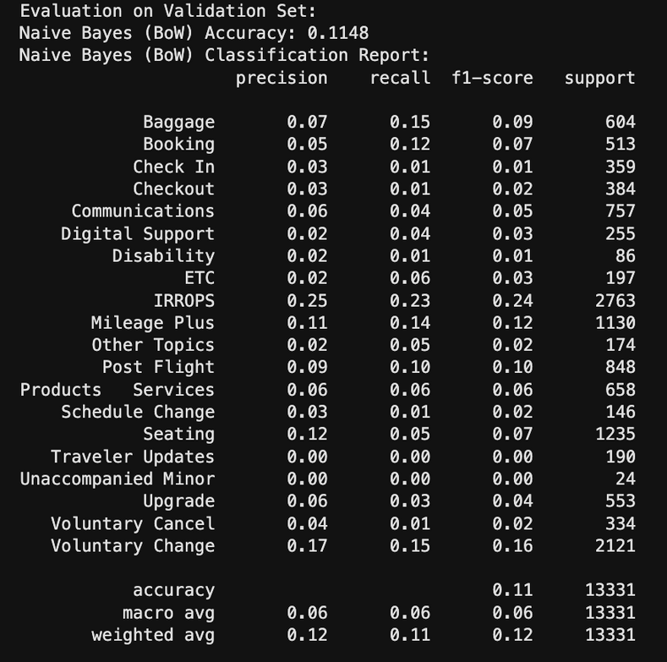
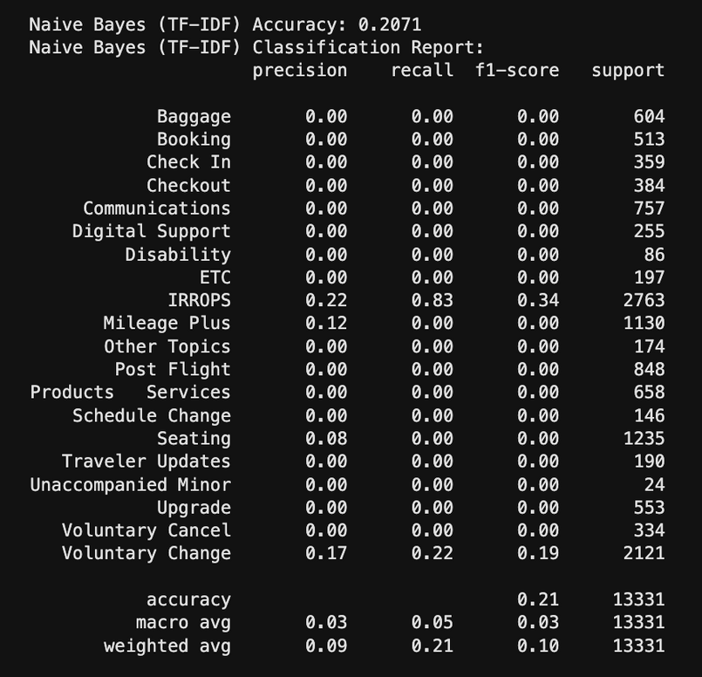
Performance of each Text Classification Model
Naive Bayes BOW and TF-IDF:

Slide 41
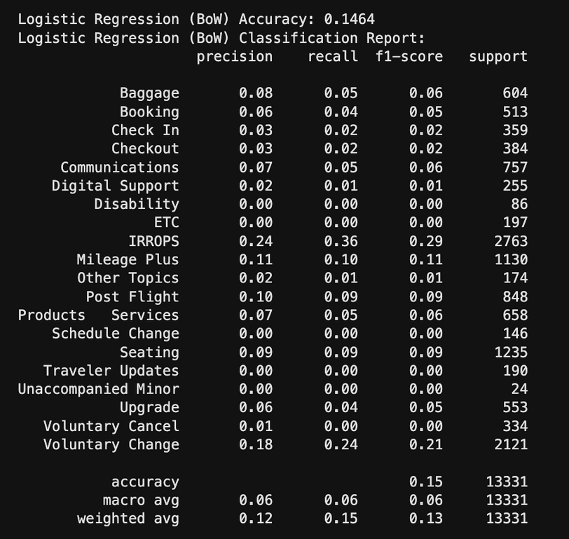
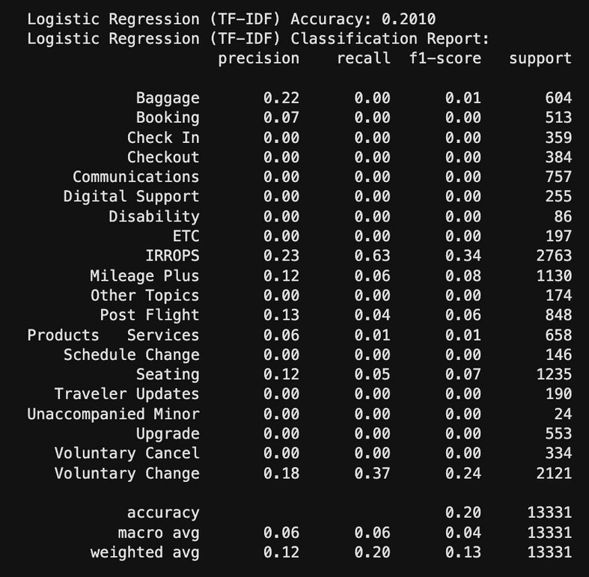
Logistic Regression BOW and TF-IDF:

Slide 42
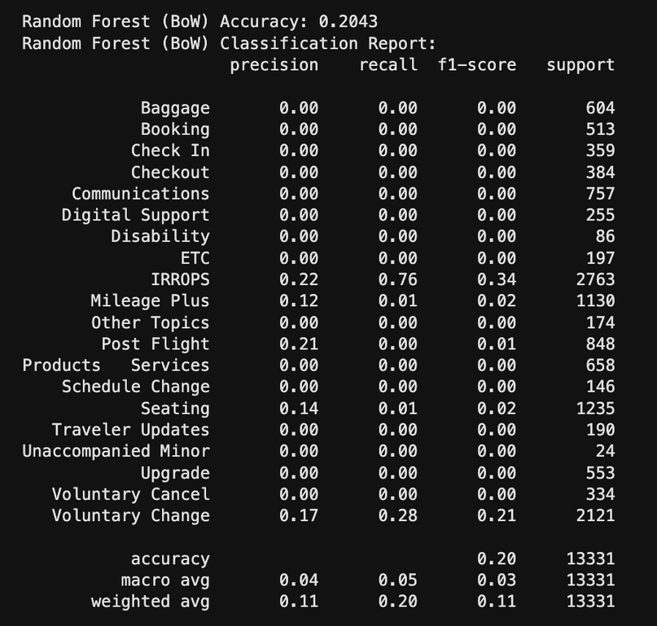
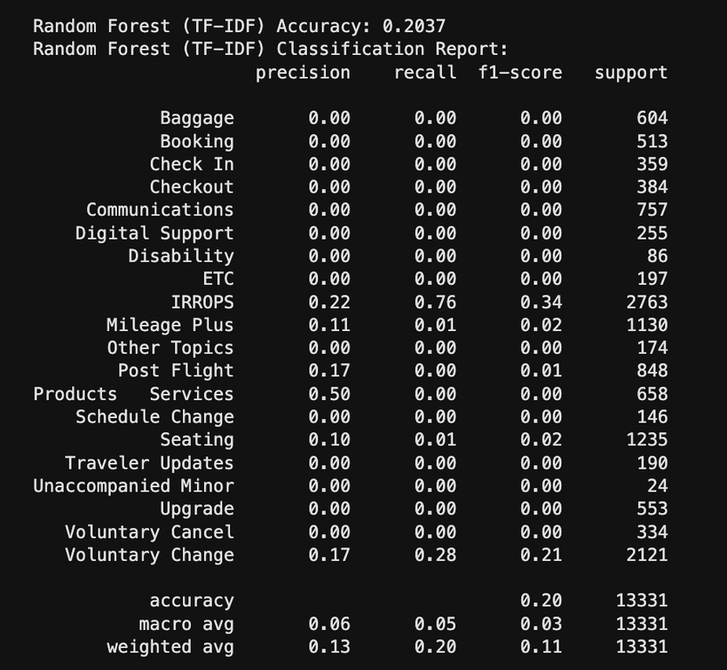
Random Forest BOW and TF-IDF:

Slide 43
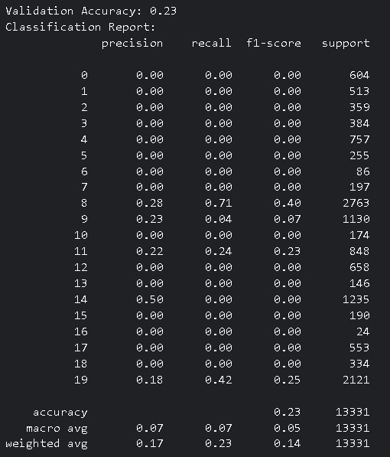
DistilBERT

Slide 44
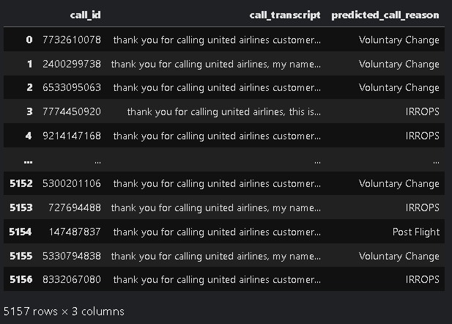
We’ll be using DistilBERT for text classification task of predicting primary reason for test.csv since it gave highest Accuracy out of all prediction models at 0.23%

Slide 45
Thank you!

